Slide 1
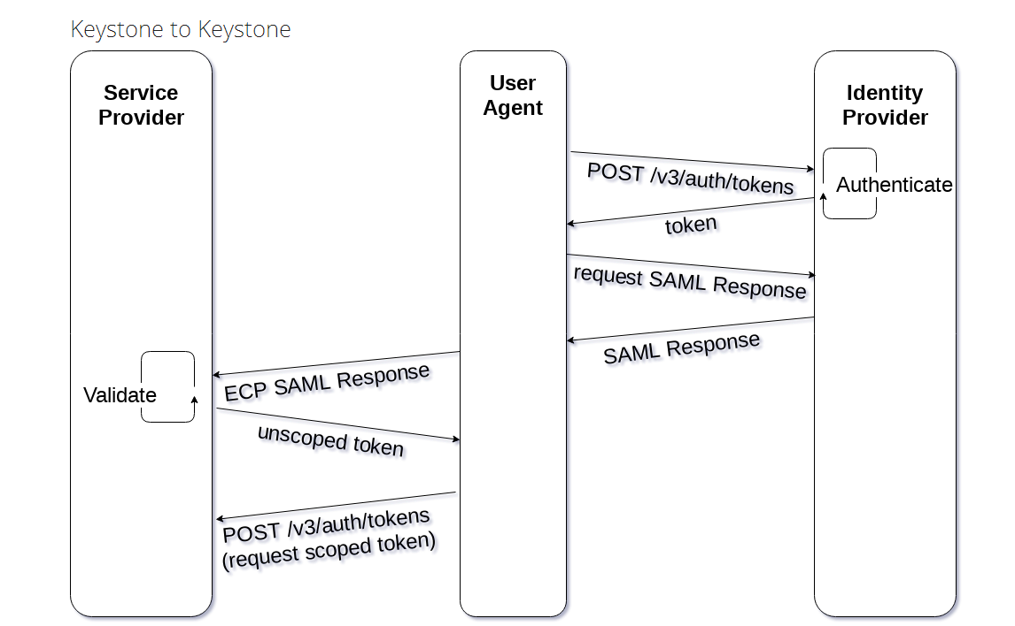

Keystone Federation for Edge Scenario
2
1
Central cloud
Keystone
Identity provider
1
Demo Step:
User requires a token through command line
After keystone federation process 1 and 2 user login to the edge cloud
Question: is step 1 and two triggered by User? Or when user trigger a login, step 1 and 2 will automatically happen in a flow?
user
Edge cloud
Edge cloud
Keystone
Keystone
2
Service provider
Service provider

Slide 2
What we can test
2
1
Central cloud
Keystone
Identity provider
1
TC1: inject packet delay. See if delay will influence the user authentication process(counting delay for authentication), and eventually the authentication fails
TC2: Inject packet loss. See if packet loss will influence the user authentication process(counting delay for authentication), and eventually the authentication fails
TC3: increasing user number with a certain amount of network delay, see if the failure rate of users will change
TC4: increasing user number with a certain amount of packet loss, see if the failure rate of users will change
user
Edge cloud
Keystone
2
Service provider

Slide 3
Working item for the demo
TASK 1: Find lab resource, requirement:
  two bare metal servers within one lab.
  L3 connections between two servers(?)
TASK 2: manually deploy a keystone to keystone environment, follow the instruction from http://www.gazlene.net/demystifying-keystone-federation.html
TASK 3: Try XCI for automating the deployment and configuration process (depend on experience from TASK 2)
TASK 4: develop test cases (depend on environment provided by TASK 2)

